Slide 1


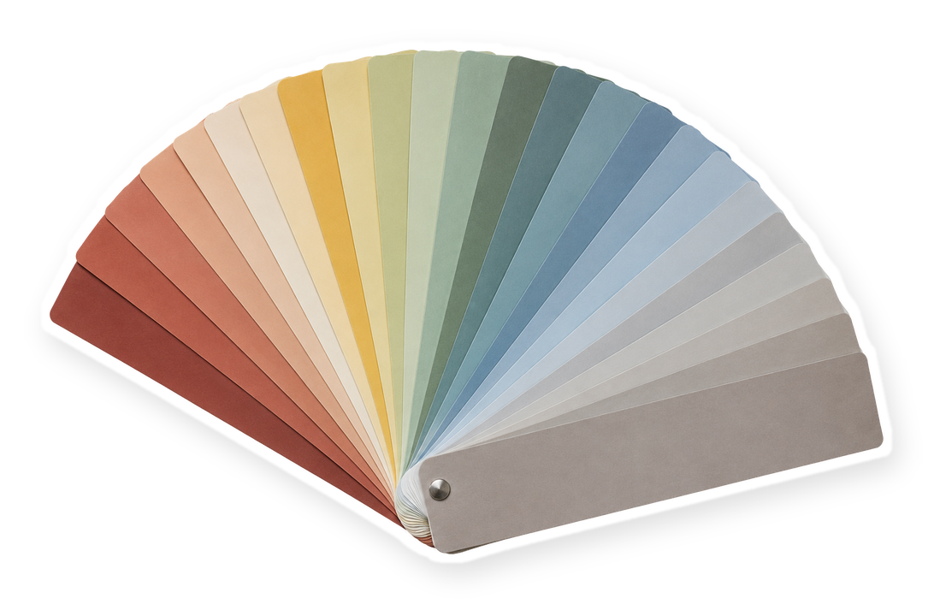
[in one swipe]
Everything blue is a guide. Delete it before you download.
Notes:
Slide 1. Hook. No photo needed. Edit the [bracket] line.

Slide 2



[can't decide?]
[see them all]
Notes:
Slide 2. Second hook: Instagram often shows a carousel starting on slide 2, so this one works as a cover on its own. Two option photos show in the lenses. Edit both [bracket] lines.

Slide 3

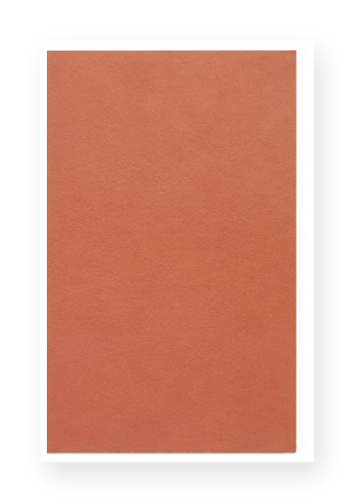
[OPTION 1]
Notes:
Slide 3. Option 1: its photo, its colour chip, its name.

Slide 4



[OPTION 2]
[OPTION 3]
Notes:
Slide 4. Options 2 and 3, one in each half.

Slide 5



[OPTION 4]
Notes:
Slide 5. Option 4 as a print on the pegboard.

Slide 6


which one?
[OPTION 5]
[OPTION 6]
Notes:
Slide 6. Options 5 and 6 side by side.

Slide 7






pause on
Notes:
Slide 7. The chips stay as they are (or recolour them to your options).

Slide 8

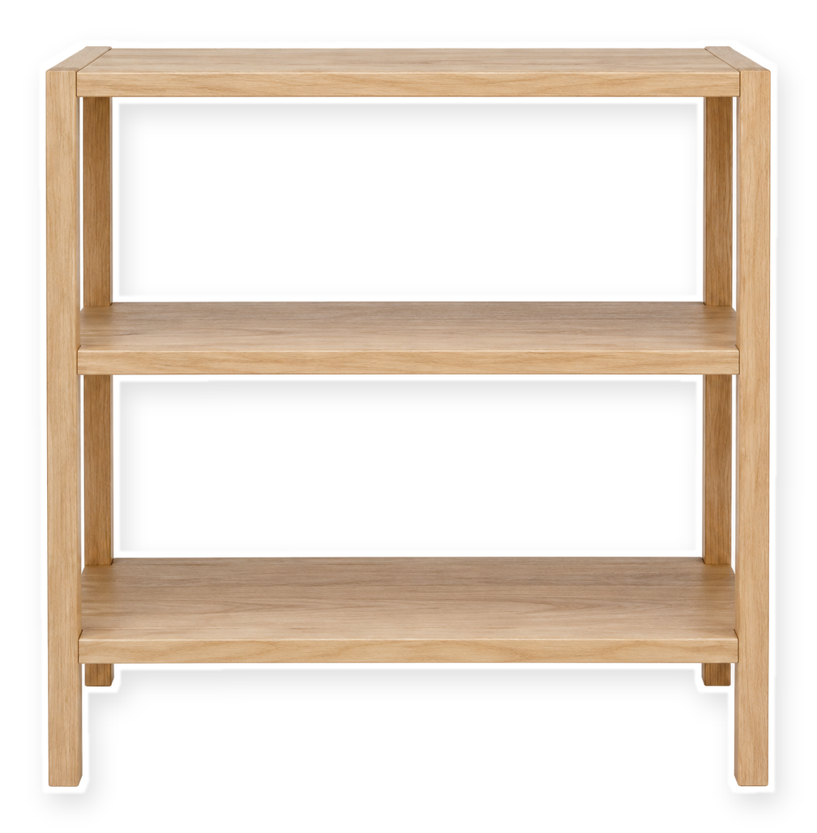


"[KEYWORD]"
all [6] at [shop]
Notes:
Slide 8. All six option photos on the shelf. Type your keyword and shop. Caption to start from (CTA in the first two sentences, 3 hashtags): Comment [KEYWORD] and I will send you [the link]. [One line of real context: who it helps or how you use it.] #[tag] #[tag] #[tag]

